Slide 1

BI Analyst Assignment
By Mojtaba Peyrovi

Slide 2
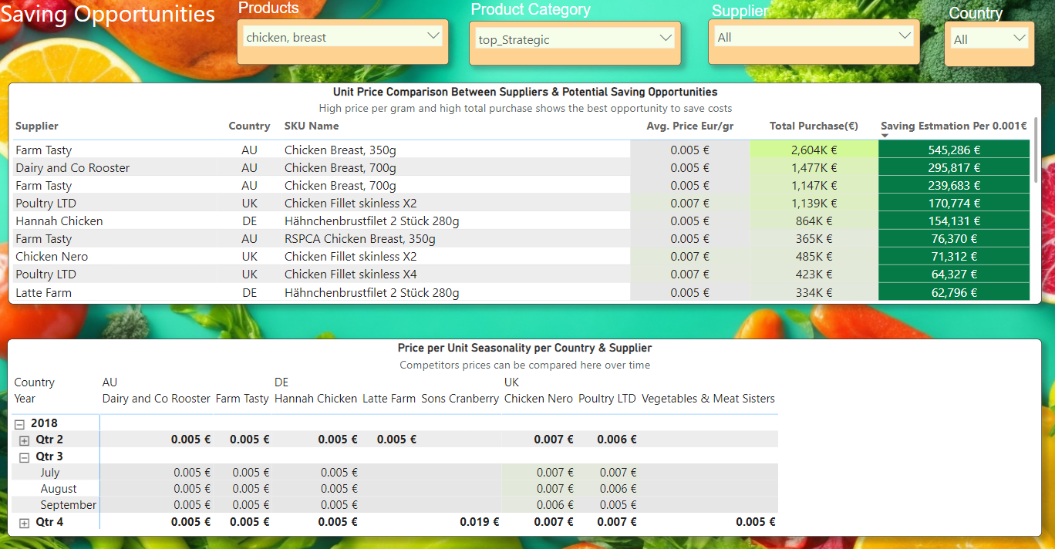
Insight One:
Price fluctuations & Potential saving opportunities
Notes:
Idea: Some

Slide 3
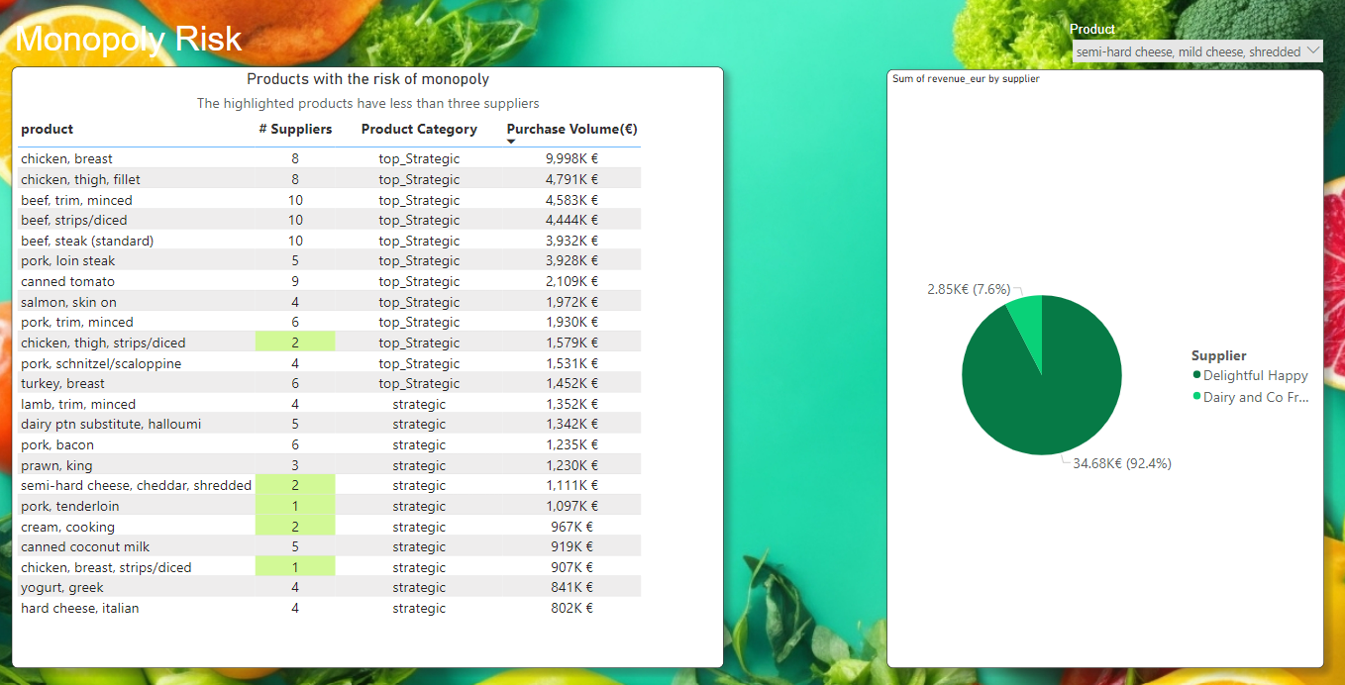
Insight Two:
There is the risk of monopoly among some suppliers

Slide 4
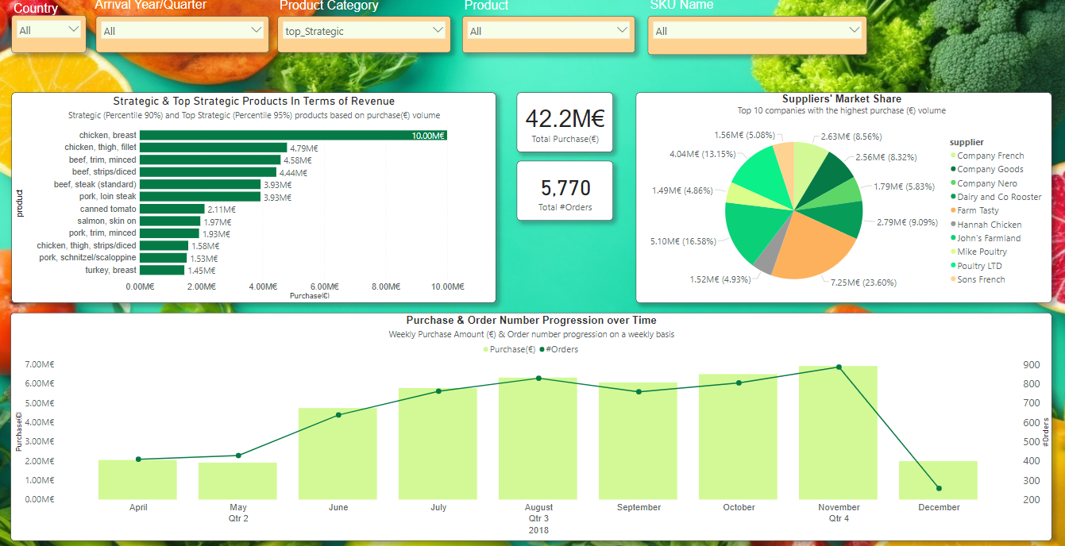
COO Dashboard:
A dashboard showing the big picture to be used by the top management

Slide 5
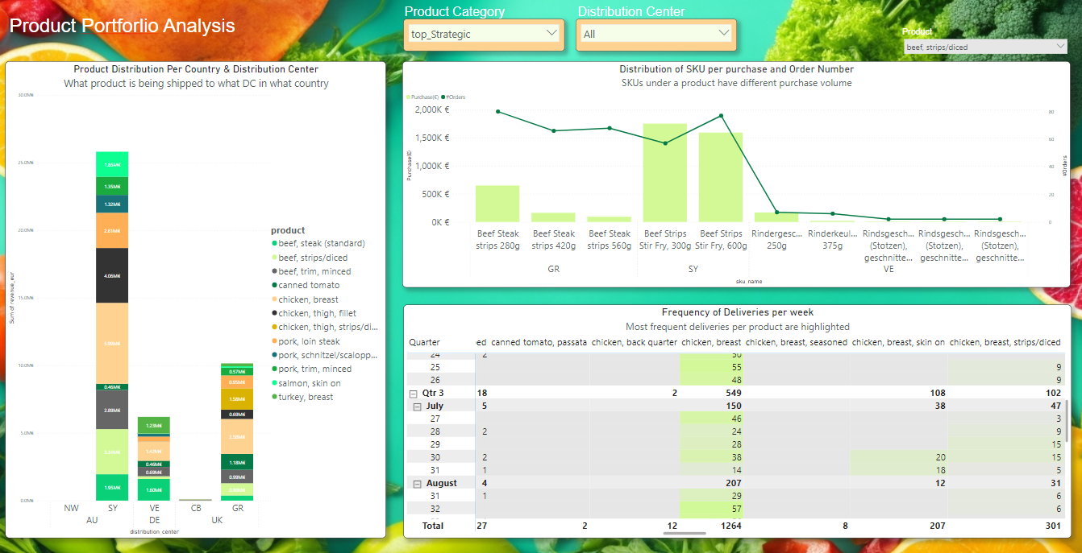
Product Portfolio Analysis:
The distribution of products and SKUs per DC, country, and delivery frequency

Slide 6
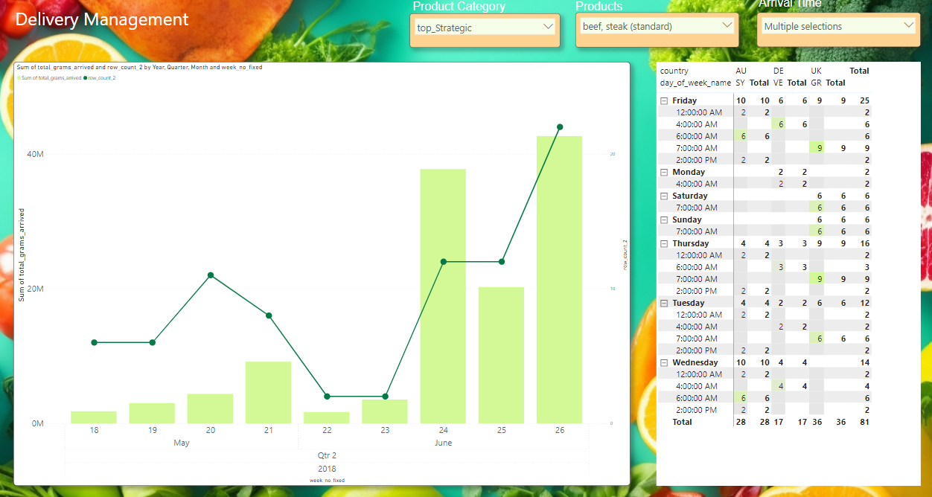
Delivery Management Dashboard:
An overview of what product is going to be delivered on what DC, what day of week at what time, and how frequently

